Slide 1

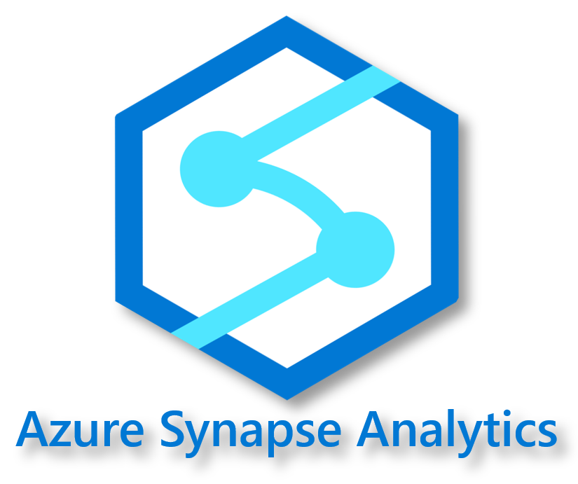

Developing HTAP Analytical Solutions with Azure Cosmos DB and Azure Synapse Analytics
Will Velida | Software Engineer | Data Platform MVP
Notes:
Good morning everyone and welcome to DataToboggan and this session, Developing hybrid transactional analytical processing solutions with Azure Cosmos DB and Azure Synapse Analytics! My name is Will and I’m a Software Engineer and Data Platform MVP. Whether you are watching from Auckland, New Zealand or elsewhere in the world right now, I hope that you’re staying safe and healthy during these challenging times.
I’m super excited to be joining you all today to talk about this feature that came into preview at Build 2020. Whenever I do a session about Cosmos DB, I’m always interested as to who in the audience has heard of Cosmos DB and who is using it just so I can get an idea of who I’m talking to, but since I can’t see you all today, I’m just going to set expectations by saying you don’t need to have had any experience using Cosmos DB (or Synapse Analytics for that matter) to be able to follow along. It doesn’t matter if you’re a Cosmos DB expert, you’ve just heard about it and haven’t used it, whatever. This session is designed to show you how you can build hybrid transactional and analytical solutions easily using Synapse Link for Cosmos DB.

Slide 2


About Me
Software Engineer based in Auckland, New Zealand.
Data Platform MVP focused on Cosmos DB, Azure Functions, s and .NET.
From the UK, based in NZ for almost 10 years now.
Notes:
But first, let me introduce myself. I’m a Software Engineer working for ASB Bank in Auckland New Zealand.
I’m also a Microsoft Data Platform MVP focusing on Azure Cosmos DB, Azure Functions, Azure Synapse, Azure Databricks and .NET in general.
I’ve been living in NZ for almost a decade now, but in case you haven’t picked up on the accent by now I’m originally from the UK

Slide 3
Agenda
What is Azure Synapse Analytics? And Azure Cosmos DB?
Running analytics on Cosmos DB before Synapse Analytics.
What is Synapse Link for Cosmos DB?
Demo
Q&A session
Notes:
So in today’s session, I’ll quickly cover what Azure Synapse Analytics is and what Azure Cosmos DB is.
Then I’ll talk a little bit about what it was like to perform analytics on Cosmos DB before Synapse Link was announced and the pain that it caused to developers and analysts alike.
Then we’ll get to the meat of our presentation and talk about what Azure Synapse Link for Cosmos DB is, how it works, what the Azure Cosmos DB Analytical Store is, what benefits Synapse Link provides us and in what situations we would actually use Synapse Link.
I’ll then go through a demo of how all the parts work together.
As we go along, feel free to ask questions to the moderators and I’ll do my best to answer them after I’ve done my talk ☺
With that out of the way, let’s start by introducing Azure Synapse Analytics and Azure Cosmos DB!

Slide 4

Azure Synapse Analytics
Integrated Analytics Service across data warehouses and big data analytics systems.
Brings together SQL, Spark and Pipelines for analytical workloads.
Web-native Studio providing a single experience for managing, coding and securing BI, AI and Machine Learning projects
Notes:
Performing analytics in the enterprise today requires operating on not just a massive amount of data, but also a variety of different data types. In the past, we would have pull technologies like Spark and SQL together and integrate them into pipelines in order to gain insights into our data, whether that would be relational data, data sitting in Data lakes, wherever.
These systems are complex and take time to build properly in order for us to build systems that can actually give us intelligent insights into our data.
Azure Synapse is an integrated analytics service that can help accelerate this process that scales across data warehouses and big data systems. We can use SQL and Spark in the same place and use pipelines to orchestrate our data movement.
Synapse comes with a web-native studio user experience that provides a single experience for managing, monitoring, securing and coding our data projects. Essentially it’s a unifed experience that brings everything that Data Engineers need in one location. It also integrates with Power BI and has built in support for AzureML so Synapse is really effective at allowing Developers and Data Engineers to build a complete solution

Slide 5



Azure Cosmos DB
A globally distributed, massively scalable, multi-model database service
SQL
MongoDB
Table API
Column-family
Document
Key-value
Graph
Guaranteed low latency at the 99th percentile
Elastic scale out
of storage & throughput
Five well-defined consistency models
Turnkey global distribution
Comprehensive SLAs
Notes:
Azure Cosmos DB is Microsoft's globally distributed, multi-model database service
Cosmos DB allows us to elastically and independently scale both throughput and storage to any Azure Region world wide
You can build databases that use Documents (SQL and MongoDB), Columnar (Cassandra), Key Value (Table) or Graph (Gremlin) format.
Cosmos DB provides you the ability to build highly responsive and available applications worldwide ensuring that your data is close to wherever your users are
Guaranteed low latency for both indexed reads and writes at the 99th percentile all around the world, providing fast query times.
Multiple consistency options (no tradeoffs between extremes)
No schema or index management (with caveats)

Slide 6






Use Cases for Azure Cosmos DB
Web Apps
IoT Apps
Recommendation Engines
Retail and E-Commerce
Gaming Apps
Serverless
Notes:
Azure Cosmos DB can be used in a variety of scenarios.
Wherever your users are, in whatever situation you need, Cosmos DB is a fantastic service that brings huge amounts of benefits for developers who want to work with a database quickly that can scale globally quickly and easily. Thanks to it’s write and read capabilities, Azure Cosmos DB is really a first class service when it comes to performing transactional workloads.

Slide 7
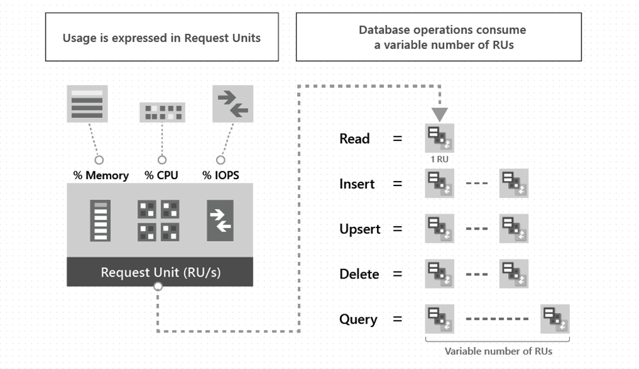
Throughput in Azure Cosmos DB
Request Units = Currency for Cosmos DB!
Charged at an hourly basis
Can provision throughput at DB or container level
Either manually set throughput or use Autoscale.
Notes:
However, when it came to performing traditional analytics on our Cosmos DB accounts, there were usually some complications that we would encounter. At this stage, it’s important to discuss the concept of Throughput in Cosmos DB and how that affected our ability to perform analytics on our data.
Request units are essentially the currency for Cosmos DB. Referred to as RU’s for short.
Request units abstracts system resources required to perform operations against our Cosmos DB account
This is across all API’s, and action we perform against our items will cost Rus
We can set this either at the database level or the container level, depending on our requirements
We use RU’s to perform operations on our Cosmos DB accounts. Approximately 1 RU will be spent on a 1KB document, while we would use 5RU for 1 write of a 1KB document. Depending on the complexity of our queries, our RU expenditure will vary (some queries might require more scans ).

Slide 8
Limitations with Cosmos DB
Provisioning extra Request Units to perform queries.
Extensive Indexing Strategies.
Cross-Partition Queries.
Would have to develop complex ETL jobs for complex analytics.
Notes:
Because of the way that Throughput works and is provisioned in Cosmos DB, this would put us as developers in a difficult spot.
In order to perform bulk analytics on our data, we would have to provision extra Request Units just to cover this. This is a waste of money and resources.
In Cosmos, indexing is automatically managed for us. Depending on the size of our documents and what consistency level our Cosmos DB accounts is set at, this also has an effect on RU consumption. We can customize our indexing policies through a variety of different strategies, along with creating composite indexes but this is time consuming.
Talk about partitioning
Data stored in Cosmos DB containers are stored in an indexed row-based transactional store. Row store format is designed to allow fast reads and writes but as our dataset grows, performing complex analytical queries can be expensive so in order to do this, we would usually extract our operational data into a separate data layer such as SQL databases or data lakes. We could do this using the Cosmos DB change feed (explain change feed) or data factory, but this can increase in complexity.

Slide 9
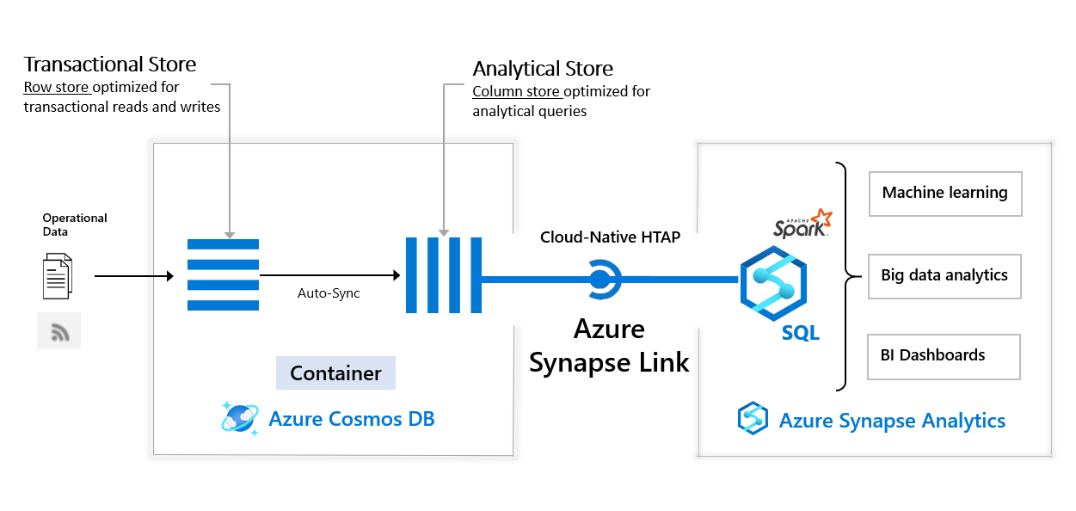
Synapse Link Integration with Cosmos DB and Synapse Analytics
Notes:
Azure Synapse Link for Cosmos DB solves our analytical requirements. It’s a hybrid transactional and analytical processing capability that allows us to run near real-time analytics over our operational data in Cosmos DB. Synapse Link integrates Azure Cosmos DB and Azure Synapse Analytics seamlessly.
Essentially, Azure Cosmos DB now has a Analytical store, which is a fully isolated column based, that enables us to perform analytics requiring no ETL on our operational data. We can use Synapse Spark or SQL to run business intelligence, machine learning or analytical workloads without impacting the performance of our transactional workloads in Cosmos DB.

Slide 10
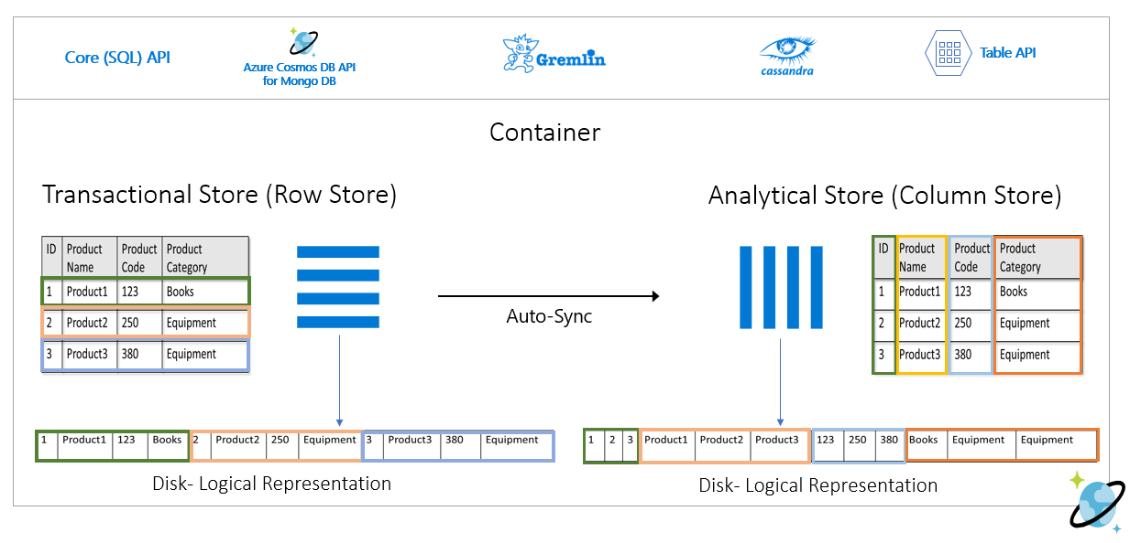
Analytical Store in Azure Cosmos DB
Notes:
In order to solve the issue with our transactional row store data, the Cosmos DB team have announced the Analytical Column Store feature which is now in preview. This analytical store address the complexity and latency challenges that I described earlier with our Row store and ETL pipeline.
The column store can automatically sync your operational data into a separate column store which is more suited to analytical queries. This requires no ETL on our part, no change feed also.This is a asynchronous operation.
When you enable the Analytical Store on a Cosmos DB container, the new column-store is internal created based on the operational data in your container. This is persisted separately from our transactional store for that container. There is no impact on the performance on our transactional workloads if we perform complex analytical queries. You don’t need to allocate request units for this to work.
Data from our transactional store is automatically synced into our analytical store within 5 minutes, so it’s fairly real-time.
Now you may be wondering, since Cosmos DB is a NoSQL database service and doesn’t worry about schema management, how can we manage this using Azure Synapse. The analytical store is optimized for analytical query performance meaning that with the auto-sync capability, Cosmos DB manages the schema inference, which includes nested properties. When our schema changes in Cosmos DB, the analytical store automatically presents a unionized schema across all historical schemas within our transactional store.

Slide 11
Analytical Time-To-Live
We can indicate how long we want to retain data in the analytical store at a container level.
We can retain data in our analytical store longer than in our transactional store.
Configured in seconds.
Notes:
Those of you who are familiar to Cosmos DB may know of the Time to Live configuration setting which we can set on a item or container basis for our transacational data. This option is now also available for data in our analytical store (but just at a container level at this time).
Inserts, updates and deletes to operational data are synched to the analytical store and irrespective of our transactional TTL, we can specify how long we want to retain data in our analytical store using Analytical TTL.
Once we’ve enabled a Analtyical TTL, we can update this value with a different value later if we need to. Currently, the Analytical TTL can only be set at the container level

Slide 12
Benefits of Azure Synapse Link
Reduced complexity with no ETL jobs
Near real-time insights on your operational data
No impact on operational data
Optimized for large-scale analytical workloads
Cost effective
Analytics on a global scale
Notes:
Synapse Link allows you to directly access your Cosmos DB analytical store without have to create any complex ETL jobs. Any updates on your transactional data will be visible to the analytical store in near real-time without you having to develop any ETL jobs to use the Change Feed.
ETL systems usually take a while to get the results you want due to the complex nature of ETL jobs. With Synpase Link, we can now analyze our operational data in near real-time, which opens up some interesting analytical scenarios for us.
There’s no impact on your operational workloads. In the past, you would have to either provision additional throughput on your Cosmos DB account to perform analytical jobs on your data or implement Change Feed jobs to store the data elsewhere. With Synapse Link, you can run analytical queries against a analytical store in Cosmos DB while leaving your transactional workloads isolated to do their thing

Slide 13
When would we use Synapse Link for Cosmos DB?
Run analytics, Machine Learning and BI over operational data in Azure Cosmos DB.
Perform analytics without developing Complex ETL jobs.
Synapse provides analytics without affecting your transactional store’s throughput.
Notes:
Synapse Link is recommended in the following cases:
If you are an Azure Cosmos DB customer and you want to run analytics, BI, and machine learning over your operational data. In such cases, Synapse Link provides a more integrated analytics experience without impacting your transactional store’s provisioned throughput. For example:
If you are running analytics or BI on your Azure Cosmos DB operational data directly using separate connectors today, or
If you are running ETL processes to extract operational data into a separate analytics system.
In such cases, Synapse Link provides a more integrated analytics experience without impacting your transactional store’s provisioned throughput.

Slide 14

Demo time!
Notes:
Alright, let’s kick off into our demo!

Slide 15
Things to note
Currently only supported for SQL and MongoDB APIs
Using Synapse SQL serverless is under gated preview
Cannot enable analytical store on existing containers in Cosmos DB.
Can’t disable analytical store after creating containers.
No impact on transactional store in terms of RU Expenditure.
Cosmos DB Analytical Store is Read-only.
Notes:
Synapse Link for Cosmos DB MongoDB API and Cassandra API accounts are under gated preiew.
The analytical store is currently read only, so we can write back any aggregation results to our Analytical store, but we can write them to another container’s transacational store, which can be used as a serving layer

Slide 16
Thanks for listening! @willvelida

